Slide 1
Program Name goes here
Link to github Repository:
Links to trello board / project management tools:
You MUST provide evidence showing how the problem has been decomposed, how the components have been developed and trialled, and of how they have been assembled and tested to create a final, working outcome.

Slide 2
Relevant Implications
You must have at least 3. You can have more if you feel you need to consider more.
Privacy
Error Recovery
Social

Slide 3
Explain the relevant implications
Implication 1 – Privacy
Privacy is where someone can release information about themselves to a selective group of people. In this case this would be the bot program and that is cannot store information or tell anyone that information

Slide 4
Explain the relevant implications
Implication 1- Privacy
Explain why it needs to be considered
Privacy as stated before is the right of a person to have the freedom of who gets to know their personal information. It is important that this information is not stored without permission or shared to the public as it's information that people could use to stalk you, send scams etc. It is also stated under the privacy act that you cannot share or store personal information without permission.

Slide 5
Explain the relevant implications
Implication 1 – Privacy
Explain how you plan to address the implication
There are many ways that we could address but one of them is by ensuring the program will flush out all the code and will nto store it anywhere.

Slide 6
Explain the relevant implications
Implication 2- Error Recovery
Describe the implication
Error recovery is where the program sends messages to the user to address the issue and to send possible solutions to the problem. In this case the Bot must be able to see what the issue is in the code if an issue arises find a solution to the issue.

Slide 7
Explain the relevant implications
Implication 2- Error Recovery
Explain why it needs to be considered
Error Recovery is important as it is the program pin-pointing the issue and helping the user find solutions rather than the user going through their information to find where they made the mistake. It is important the program can help with error recovery as if not, the user may have to restart the program and re-enter the information they need to.

Slide 8
Explain the relevant implications
Implication 2-privacy
Explain how you plan to address the implication
Do ensure that the user can recover from errors I will be using the validation code and the value error code to alert the user as soon as an incorrect or non- valid code has been entered.

Slide 9
Explain the relevant implications
Implication 3- Social
Describe the implication

Slide 10
Explain the relevant implications
Implication 3
Explain why it needs to be considered

Slide 11
Explain the relevant implications
Implication 3
Explain how you plan to address the implication

Slide 12
Decomposition
Paste screenshots of your initial Trello board / task decomposition on this slide. If you have a long list, you might need to break it up into several columns. Delete this instruction when you are done.
Notes:
Paste screenshots of your initial Trello board / task decomposition on this slide. If you have a long list, you might need to break it up into several columns. Delete this instruction when you are done.

Slide 13
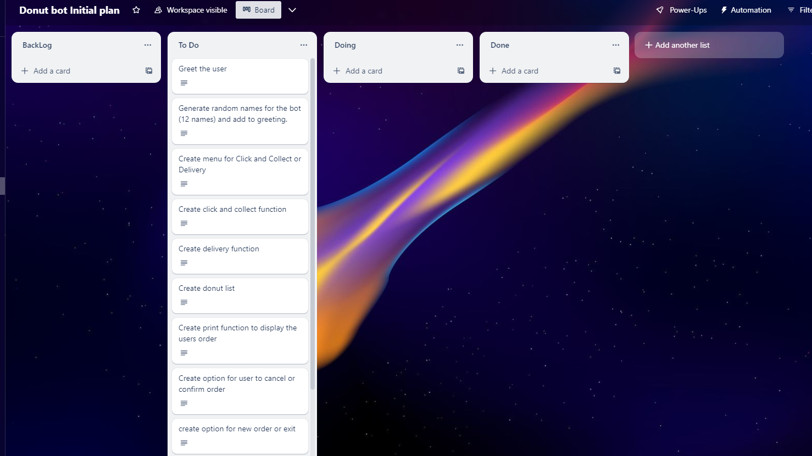
Decomposition
Notes:
Paste screenshots of your initial Trello board / task decomposition on this slide. If you have a long list, you might need to break it up into several columns. Delete this instruction when you are done.

Slide 14
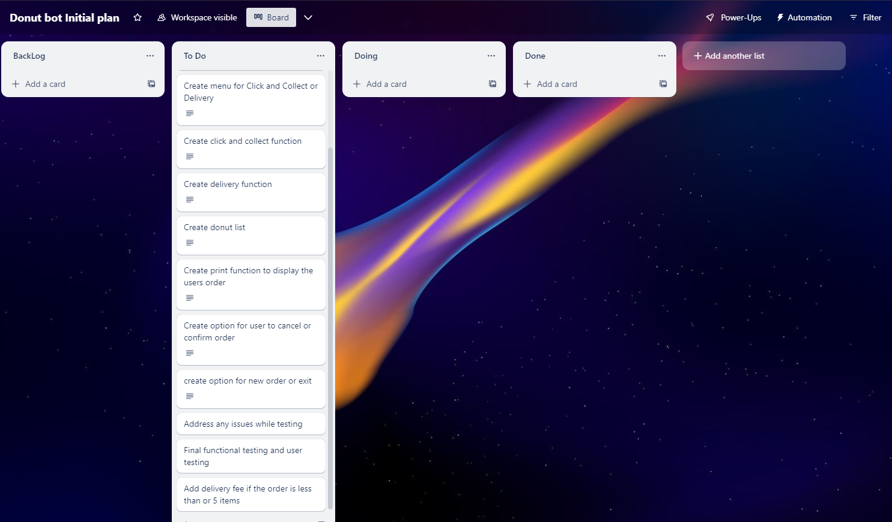
Decomposition
Notes:
Paste screenshots of your initial Trello board / task decomposition on this slide. If you have a long list, you might need to break it up into several columns. Delete this instruction when you are done.

Slide 15
Component Section
Duplicate Slides so that you have TRELLO and a TEST for each component

Slide 16
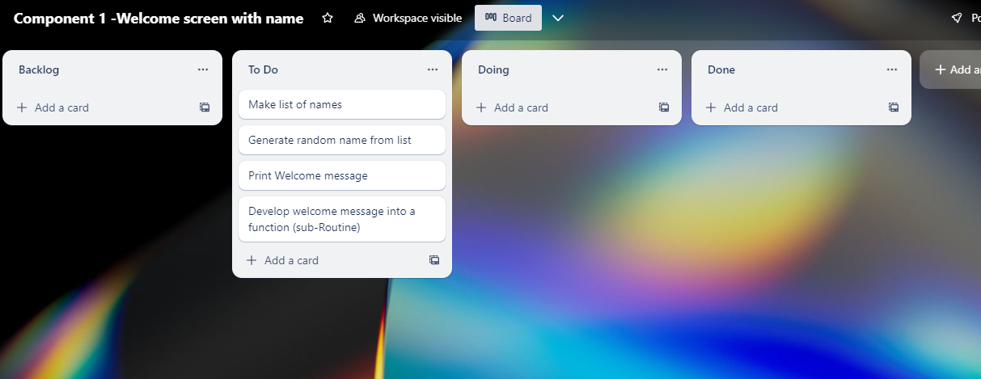
Component 1 Welcome Message version 1 (Trello
screenshot)

Slide 17
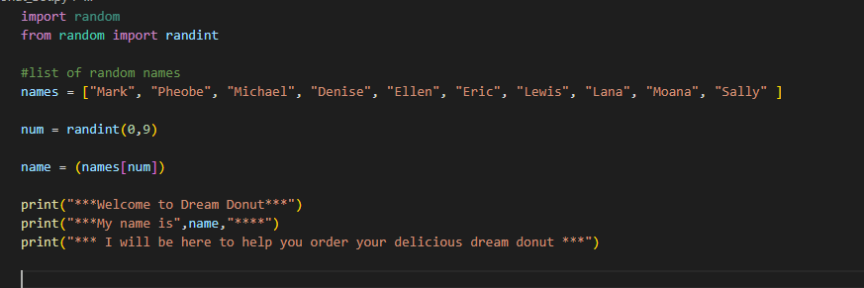

Component 1 - Test Plan (?and screenshot)
Test Case | Expected Values
Run Program | Print Welcome message with random names from list of names – Runs correctly

Slide 18
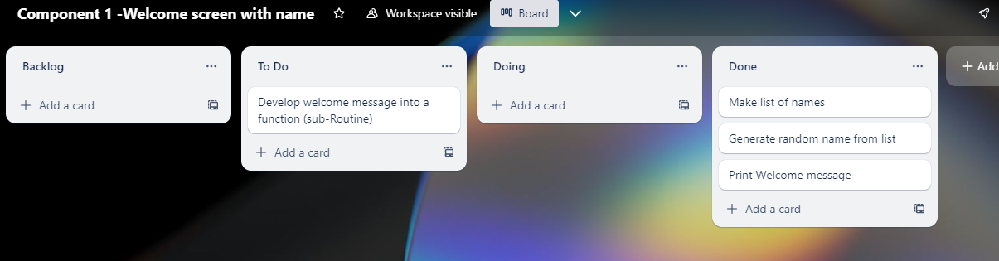
Component 1 – Welcome message version 2 (Trello
screenshot)

Slide 19
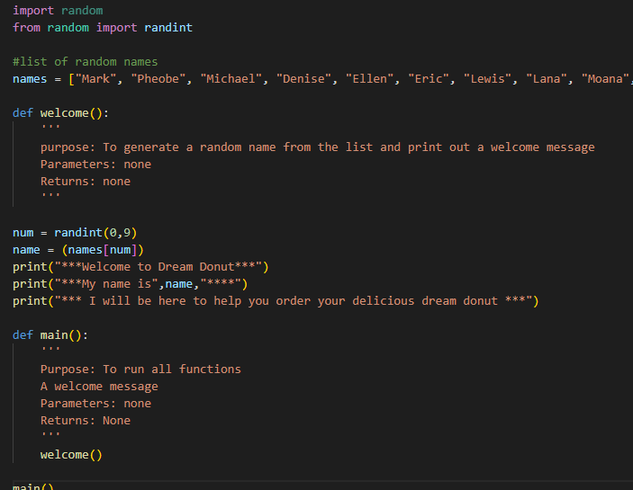

Component 1 – v2 Test Plan (?and screenshot)
Test Case | Expected Values
Run Program | Main and welcome run correctly. Welcome message prints with random name

Slide 20
Component 2 – Pickup/delivery choice version 1
(Trello screenshot)

Slide 21
Component 2 - Test Plan (?and screenshot)
Test Case | Expected Values

Slide 22
Component 3 (Trello screenshot)

Slide 23
Component 3 - Test Plan (?and screenshot)
Test Case | Expected Values

Slide 24
Component 4 (Trello screenshot)

Slide 25
Component 4 - Test Plan (?and screenshot)
Test Case | Expected Values

Slide 26
Component 5 (Trello screenshot)

Slide 27
Component 5 - Test Plan (?and screenshot)
Test Case | Expected Values

Slide 28
Component 6 (Trello screenshot)

Slide 29
Component 5 - Test Plan (?and screenshot)
Test Case | Expected Values

Slide 30
Version Control Section Section
Duplicate Slides if required – Show screenshot of GitHub commits and comments

Slide 31
Version Control Evidence
Your version control evidence should go here. This could be in the form of annotated screenshots which show you you managed this process or you could make a brief screencast explaining how you implemented version control.
Notes:
Your version control evidence should go here. This could be in the form of annotated screenshots which show you you managed this process or you could make a brief screencast explaining how you implemented version control.

Slide 32
Python Code Conventions
Show screenshot of PEP8 testing both before and after.

Slide 33
Python convention testing (PEP8)
Screenshot of errors
Notes:
Your version control evidence should go here. This could be in the form of annotated screenshots which show you you managed this process or you could make a brief screencast explaining how you implemented version control.

Slide 34
Python convention testing (PEP8)
Screenshot after errors fixed
Notes:
Your version control evidence should go here. This could be in the form of annotated screenshots which show you you managed this process or you could make a brief screencast explaining how you implemented version control.

Slide 35
Discusses how the information from planning, testing and trialling of components assisted in the development of a high-quality outcome
Notes:
Discusses how the information from planning, testing and trialling of components assisted in the development of a high-quality outcome

